Slide 1
UNIFIED POWER FLOW CONTROLLER (UPFC)

Slide 2
U (Unified) P (Power) F (Flow) C (Controller)

Slide 3
Main Advantages of UPFC
The main advantages of the UPFC is to control both active and reactive power flow in the transmission line.
If there are any disturbances or faults in the source side, the UPFC will not work.
The UPFC operates only under balanced sine wave source.
The controllable parameters of the UPFC are reactance in the line, phase angle and voltage.
The UPFC allows to suppress power system oscillations and improving the transient stability of power system

Slide 4
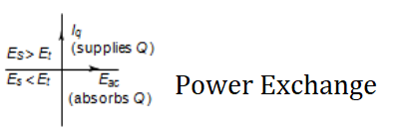
STATCOM OPERATION
If the amplitude of the output voltage is increased above that of the utility bus voltage, then a current flows through the reactance from the converter to the AC system and the converter generates capacitive-reactive power for the ac system.
If the amplitude of the output voltage is decreased below utility bus voltage, then a current flows the AC system to the converter and the converter absorbs inductive-reactive power from the ac system.
If the amplitude of the output voltage equals the AC system voltage, the reactive power exchange becomes zero, in such case STATCOM is said to be in Floating State.

Slide 5
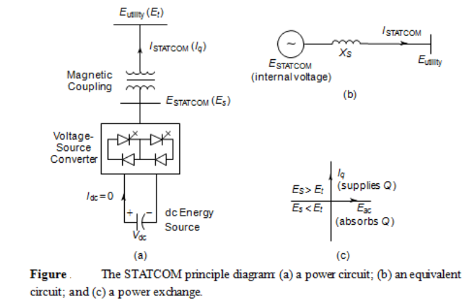
Static Synchronous Compensator (STATCOM)
E_{t} is the Utility System Voltage.
E_{s} is the STATCOM Voltage.
If E_{s}>E_{t} then Current Inject and Travel from E_{s}> to E_{t}> ↑
If E_{t}>E_{s} then Current Absorb and Travel from E_{t} to E_{s} ↓

Slide 6
Static Synchronous Compensator (STATCOM)
In practice, the semiconductor switches of the converter are not lossless, so the energy stored in the dc capacitor is eventually used to meet the internal losses of the converter, and the dc capacitor voltage diminishes.
When the STATCOM is used for reactive-power generation, the converter itself can keep the capacitor charged to the required voltage level. This task is accomplished by making the output voltages of the converter lag behind the AC-system voltages by a small angle (usually in the 0.18-0.28 range).
In this way, the converter absorbs a small amount of real power form the AC system to meet its internal losses and keep the capacitor voltage at the desired level.

Slide 7
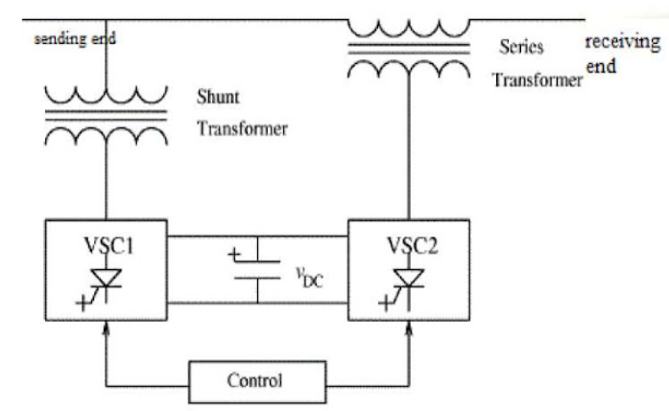
UPFC
DC Link Capacitor
The UPFC concept was described in 1995 by L. Gyugyi
UPFC is a combined combination of Series and Shunt Compensation.
UPFC is a combined combination of Static Synchronous Compensator (STATCOM) and Static Series Compensator.
UPFC are coupled via a DC link to allow bidirectional (both directions) flow of real/reactive power between the series output terminals of the SSSC and the shunt output terminals of the STATCOM
Figure: Basic UPFC Scheme

Slide 8
Applications
Used in HVDC transmission system.
Use of UPFC for optimal power flow control.
For enhancement of voltage profile & minimization of losses.
Increase transient stability of inter area power system.
For damping power system oscillation.

